Slide 1
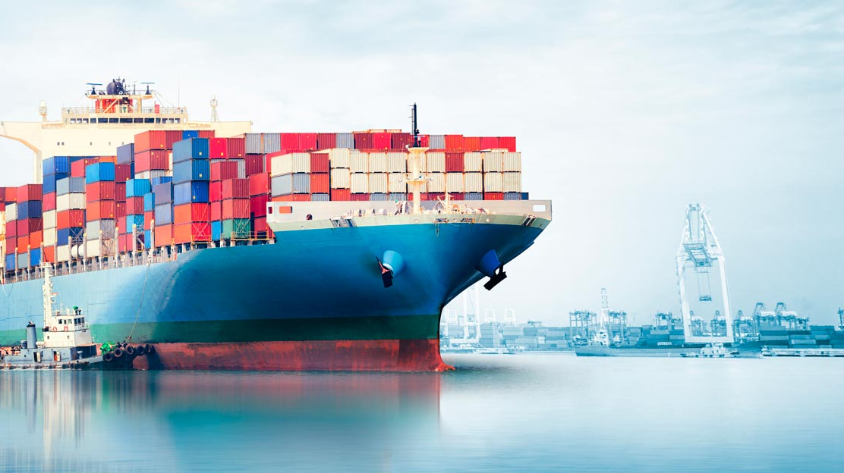
Progress sprint 7 @ Saab
11-12-2019

Slide 2
Last time:

Slide 3

The void™
Predict ship routes?
Cluster?
Predict?
Cluster?

Slide 4
Now:
Both plans
Neural Network
Start off simple
Statistical approach

Slide 5
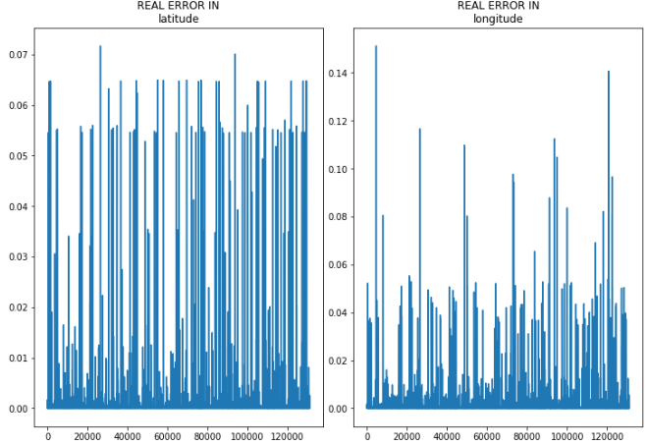
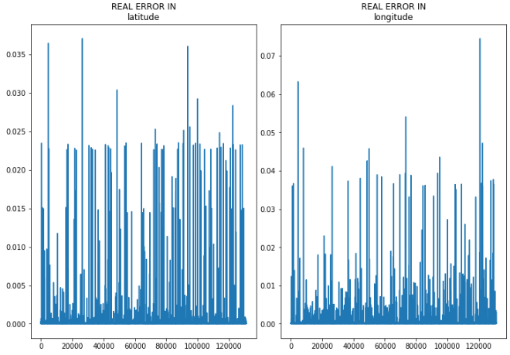
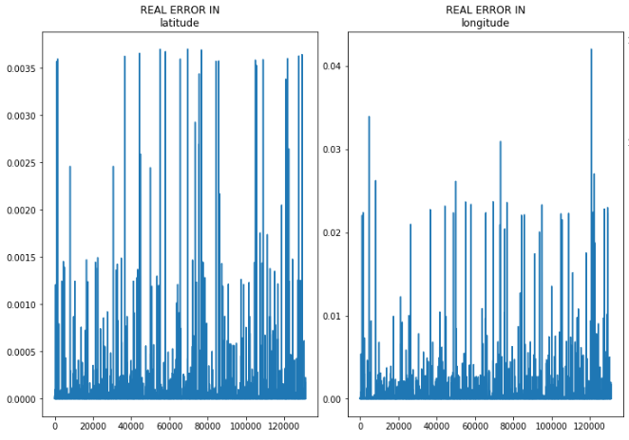
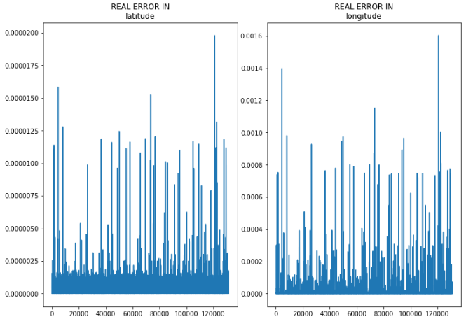
Results NN:
Best results:
300.000 rows input
Validation: 100.000
1000 nodes
1 hidden layer
Rmse: 0.0050

Slide 6
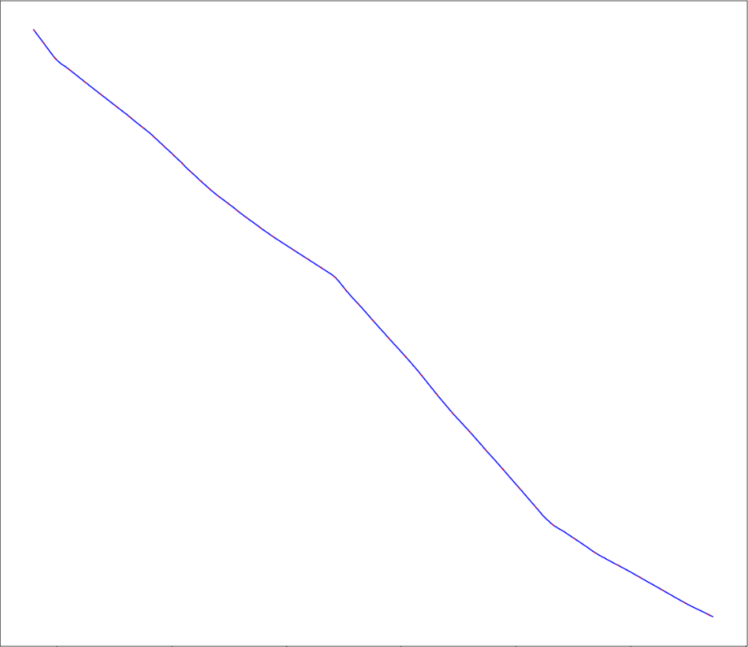
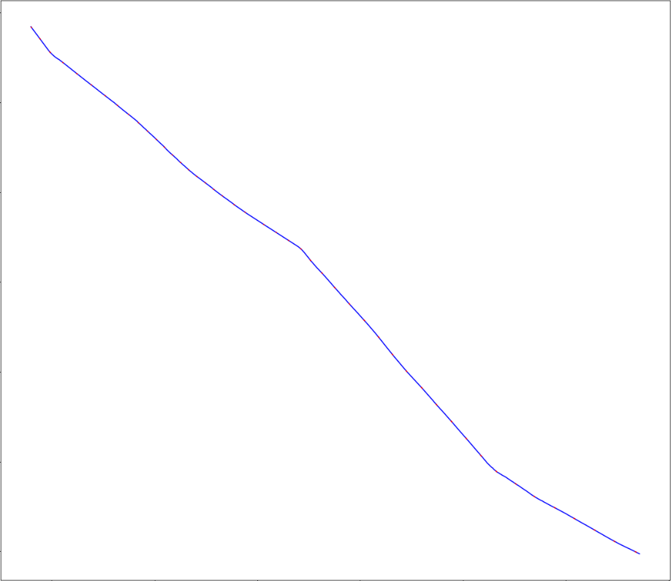
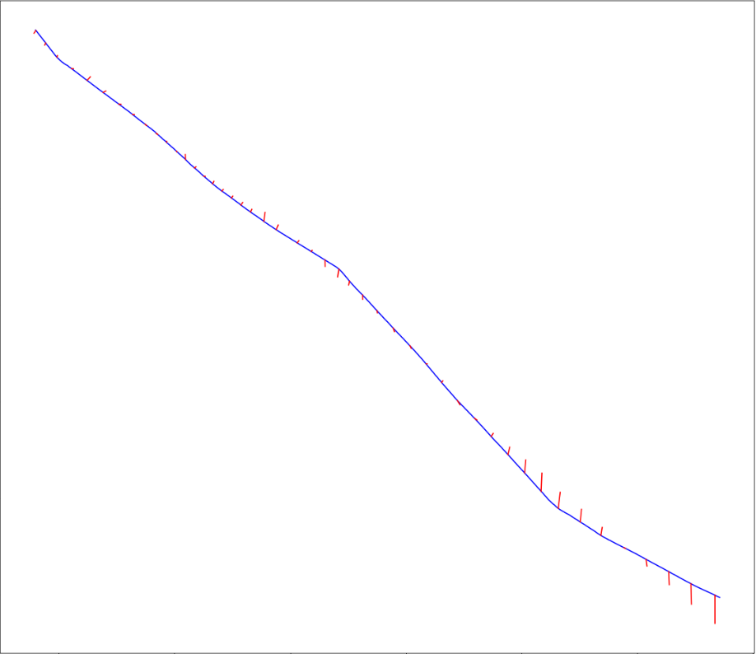
Results NN:
Adding new features

Slide 7
Results NN
without: 2500 0.01s train rmse: 0.000872 valid rmse: 0.000882
With extra feature: 3000 0.01s train rmse: 0.001009 valid rmse: 0.000945
With hidden layer: 10000 0.02s train rmse: 0.044894 valid rmse: 0.048481

Slide 8
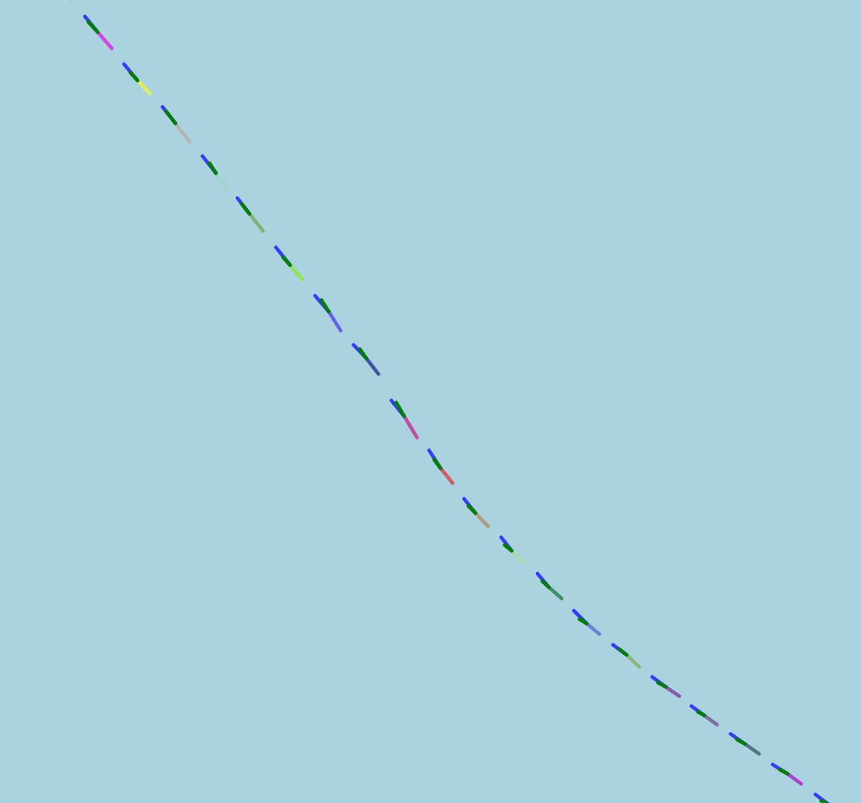
Results NN:
Linear model
different layer for lat and long

Slide 9
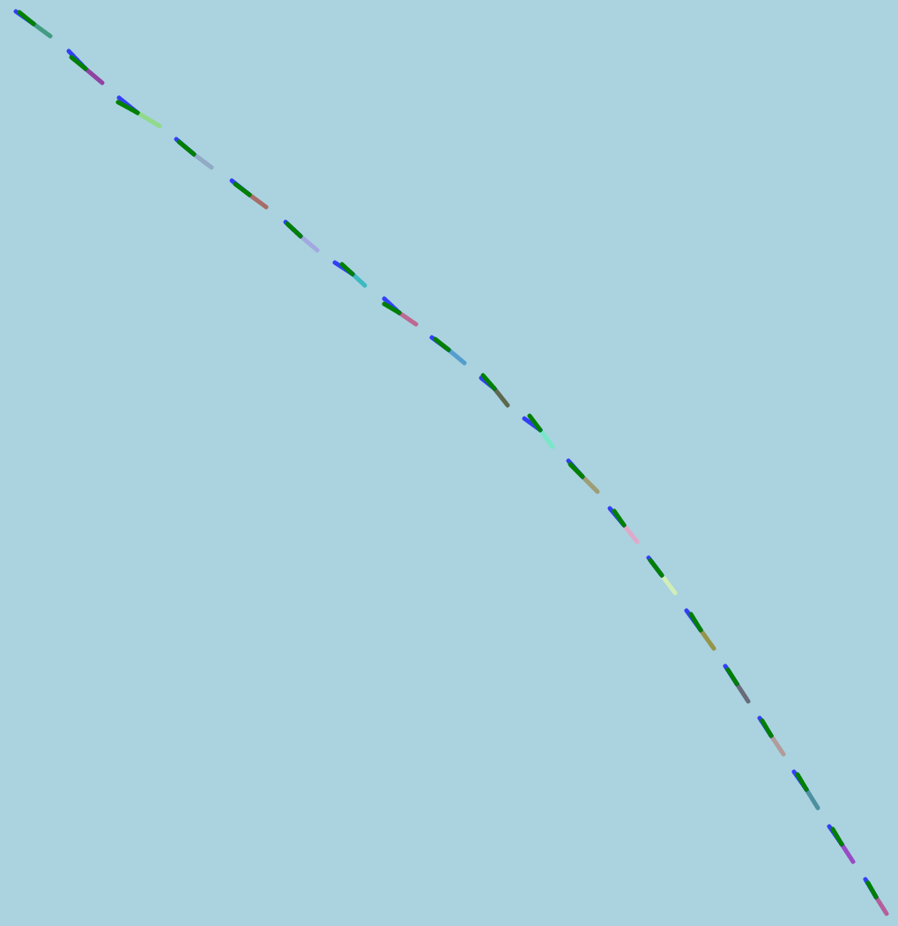
Results NN:
Linear model
different layer for lat and long

Slide 10
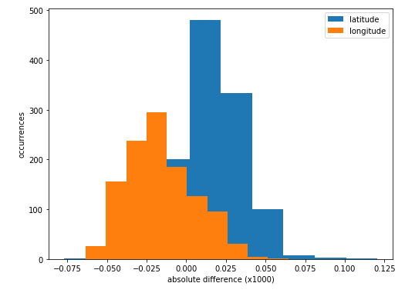
Results NN:
Linear model
different layer for lat and long

Slide 11
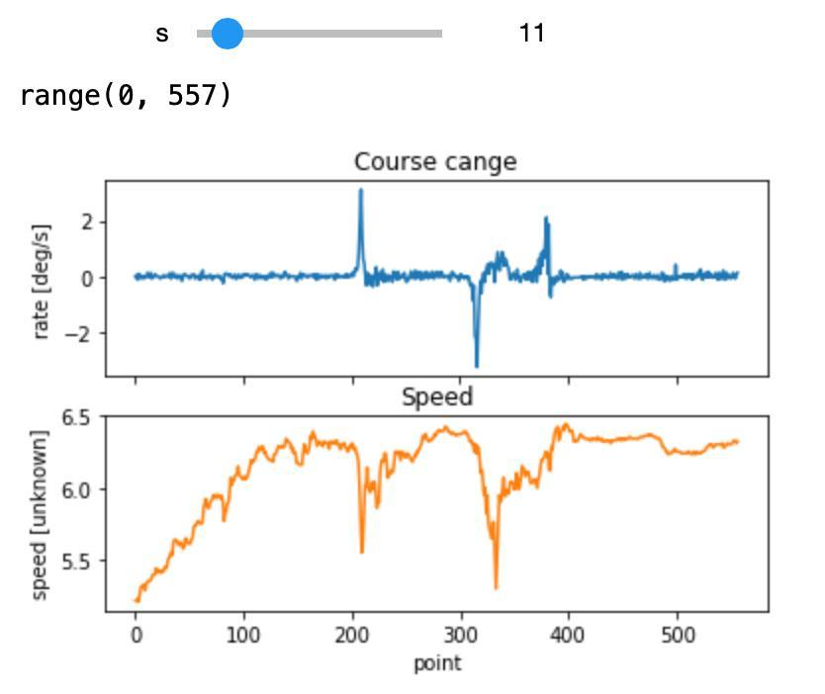
Results statistical approach
Angular speed
Rate of course change with speed
Change

Slide 12

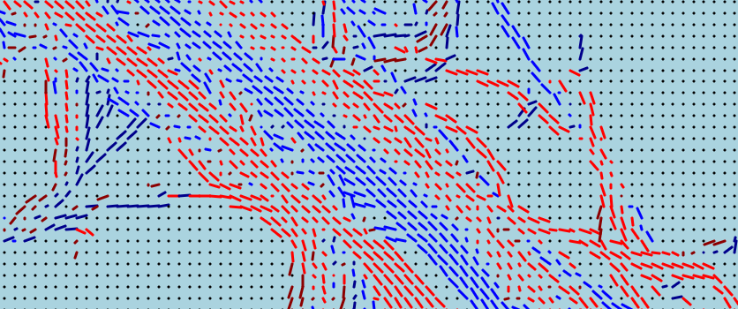
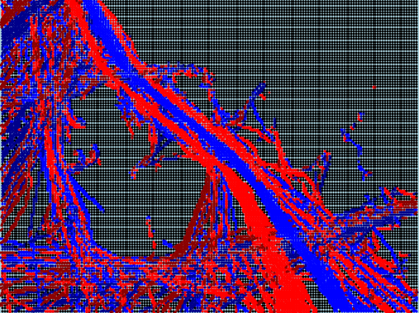
Results statistical approach:
Directional Map

Slide 13
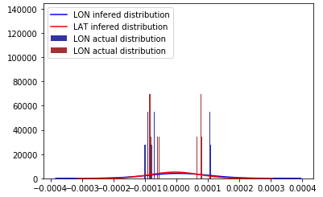
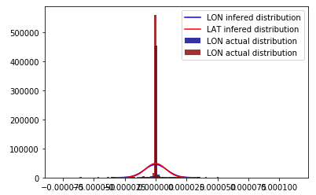
Results statistical approach:
For every node, we compute the the history of directions and we plot the average of them (previous plot).
Aproximate the directions with a normal distribution, to get its density function:

Slide 14
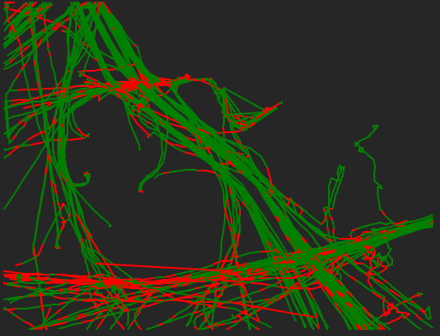
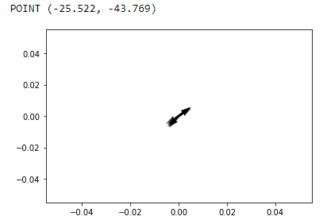
Results statistical approach:
Noise is normal (small segments that are detected as anomaly). They can get pooled.
Back to previous example:

Slide 15
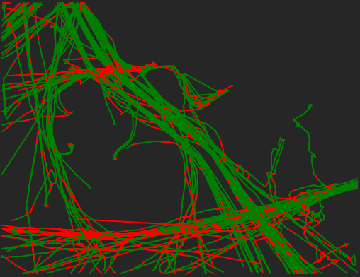
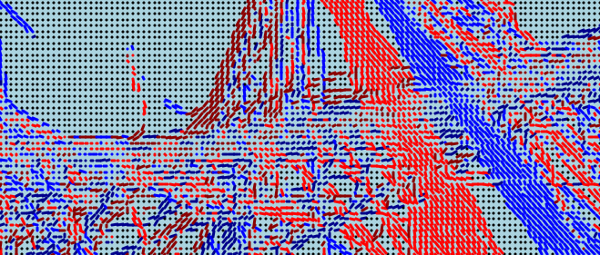
Results statistical approach:

Slide 16
Results statistical approach:
SOLUTIONS:
Multi-peak normal distribution inference for each node.
Do not aproximate it with a normal distribution but do some basic probability calculation.
Look for the N most repeated directions at each mode (SOMEHOW with a low computational cost).
Take into account nodes environment (Now just one is taken into account).
Make the grid bigger → Empty nodes → Creating points within a segment to fullfil them.
Not taking into account the directions → Work with absolute values

Slide 17
Questions?

